Slide 1
Las Vegas strip
Exploratory data analysis

Slide 2
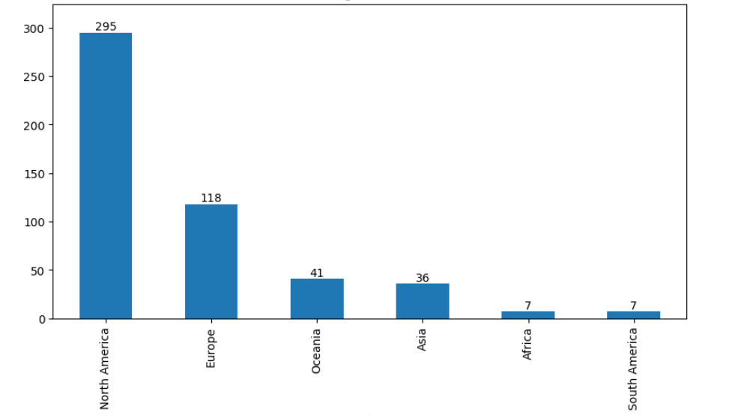
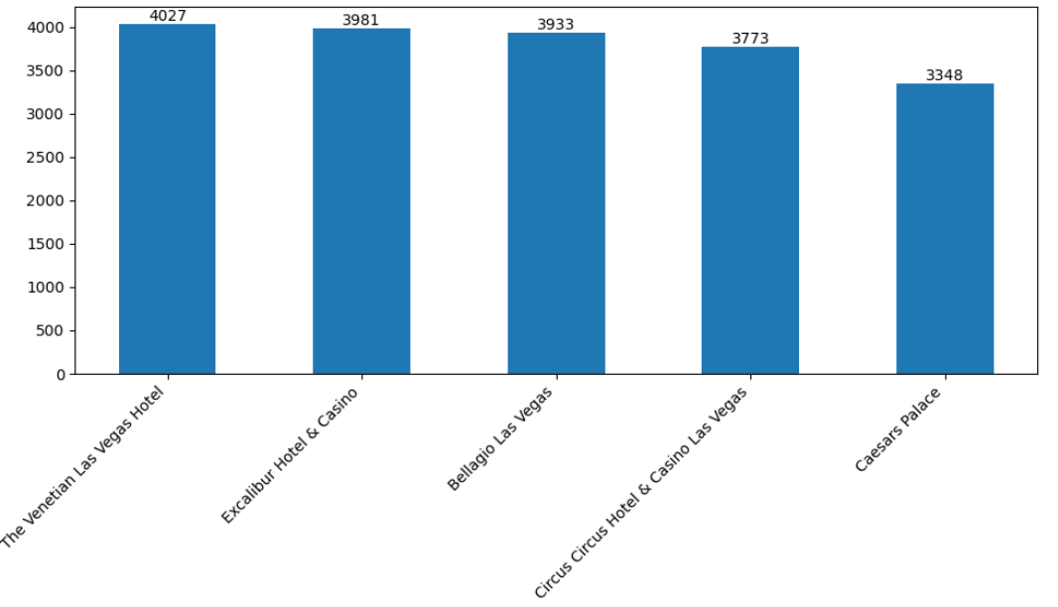
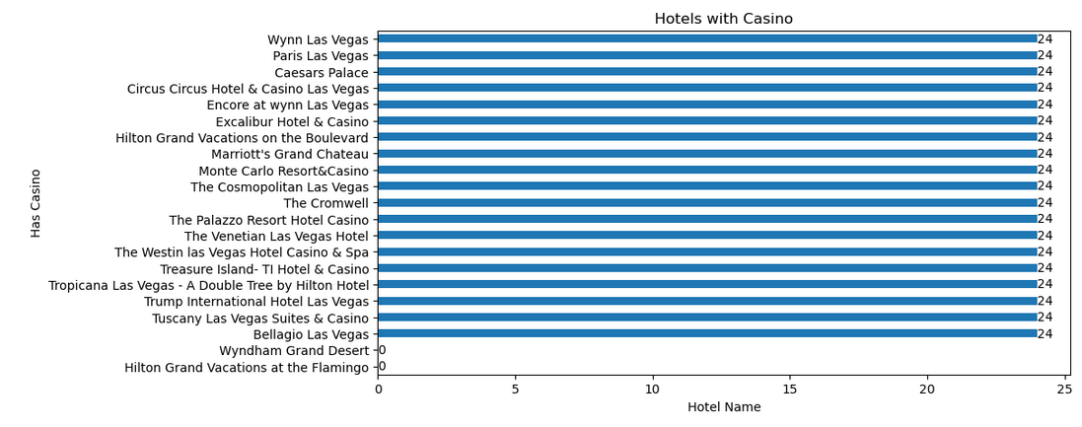
Hotels Listing across Continents
Distribution of Hotel Rooms
Total Number of Hotels with Casino
Observation :
Most of the hotels are located in North America.
Most the Hotels located across all continents having Casino Facility except Wyndham Grand Desert and Hilton Grand Vacations at the Flamingo
The venetian Las Vegas Hotel having the more number of rooms compared to all other hotels

Slide 3
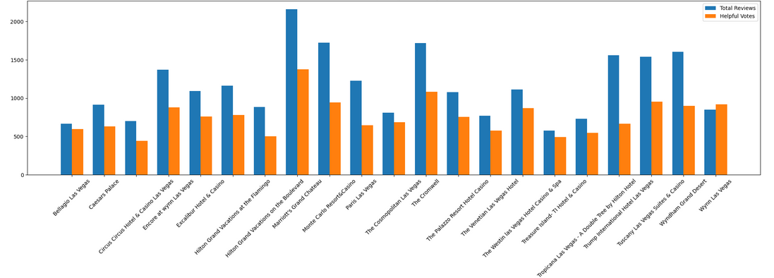
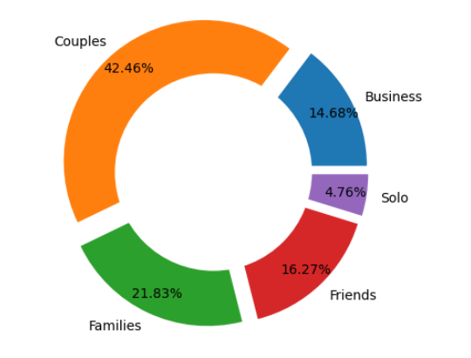
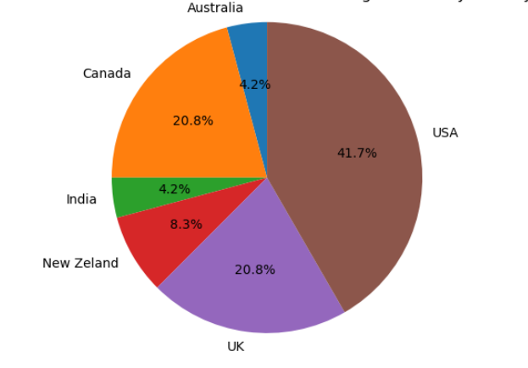
Total Reviews and Helpful Votes of all Hotels
Circus Circus Hotel & Casino Las Vegas Hotels by Country
Classification based on Travaller Type
Observation:
Hilton Grand vacations on the Boulevard having more number of reviews and also helpful Votes
Based on the classification of Traveller type, can see more number of couples were travelled
Distribution of Circus Hotel by country level shows more number of hotels located in USA

Slide 4
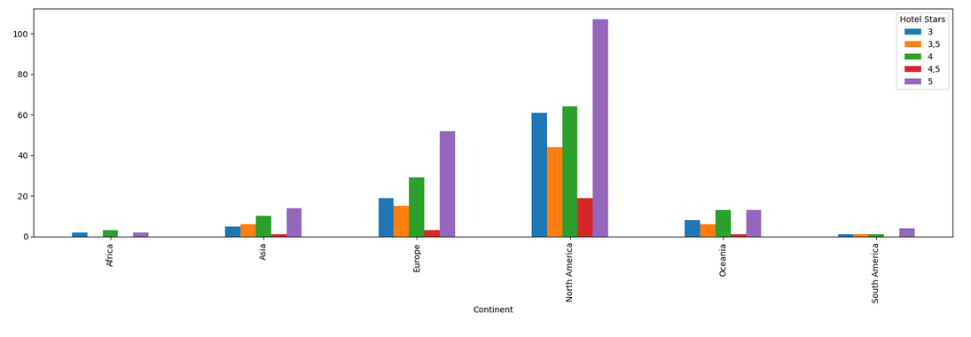
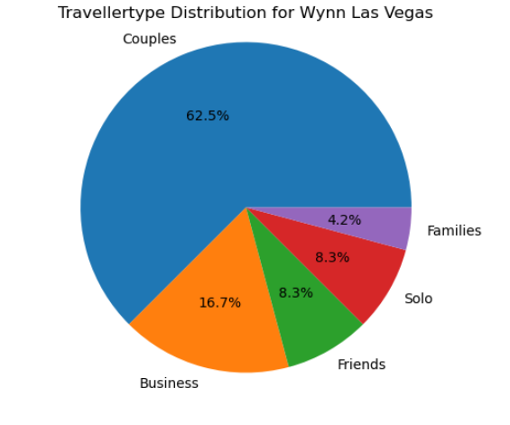
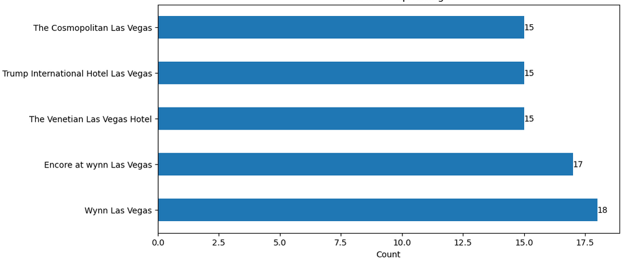
Number of Hotels located across continents based on Hotel Stars
Top 5 Hotels count with Rating “5”
Observation:
Most of the Top rated Hotels are located first in North America and then Europe have second place
More number of Top rating (Rating ‘5’) hotel is ‘Wynn Las Vegas’ and having more ‘Couples’ traveller type

